Slide 1
Number Sequences
?
overhang

Slide 2
This Lecture
We will study some simple number sequences and their properties.
The topics include:
Representation of a sequence
Sum of a sequence
  Arithmetic sequence
  Geometric sequence
    Applications
  Harmonic sequence
Product of a sequence
  Factorial

Slide 3
Number Sequences
In general a number sequence is just a sequence of numbers
a₁, a₂, a₃, …, a_{n} (it is an infinite sequence if n goes to infinity).
We will study sequences that have interesting patterns.
e.g. a_{i} = i
1, 2, 3, 4, 5, …
a_{i} = i²
1, 4, 9, 16, 25, …
a_{i} = 2^{i}
2, 4, 8, 16, 32, …
a_{i} = (-1)^{i}
-1, 1, -1, 1, -1, …
a_{i} = i/(i+1)
1/2, 2/3, 3/4, 4/5, 5/6, …

Slide 4
Finding General Pattern
Given a number sequence, can you find a general formula for its terms?
a₁, a₂, a₃, …, a_{n}, …
General formula
1/4, 2/9, 3/16, 4/25, 5/36, …
1/3, 2/9, 3/27, 4/81, 5/243,…
0, 1, -2, 3, -4, 5, …
1, -1/4, 1/9, -1/16, 1/25, …
a_{i} = i/(i+1)²
a_{i} = i/3^{i}
a_{i} = (i-1)·(-1)^{i}
a_{i} = (-1)^{i+1} / i²

Slide 5
Recursive Definition
We can also define a sequence by writing the relations between its terms.
e.g.
1 when i=1
a_{i} =
1, 3, 5, 7, 9, …, 2n+1, …
a_{i-1}+2 when i>1
1 when i=1
1, 2, 4, 8, 16, …, 2^{n}, …
a_{i} =
2a_{i-1} when i>1
1 when i=1 or i=2
Fibonacci sequence
a_{i} =
a_{i-1}+a_{i-2} when i>2
1, 1, 2, 3, 5, 8, 13, 21, …, ??, …
Will compute its general formula in a later lecture.

Slide 6
Proving a Property of a Sequence
What is the n-th term of this sequence?
3 when i=1
a_{i} =
(a_{i-1})² when i>1
Step 1: Computing the first few terms, 3, 9, 81, 6561, …
n
Step 2: Guess the general pattern, 3, 3², 3⁴, 3⁸, …, 3² ? ,…
Step 3: Verify it.
Check a₁=3
i-1
i
In general, assume a_{i}=3² , show that a_{i+1}=3²
i-1
i
a_{i+1} = (a_{i})² = (3² )² =3²
(We can be more formal after we learned proof by induction.)

Slide 7
This Lecture
Representation of a sequence
Sum of a sequence
  Arithmetic sequence
  Geometric sequence
    Applications
  Harmonic sequence
  (Optional) The integral method
Product of a sequence
  Factorial

Slide 8
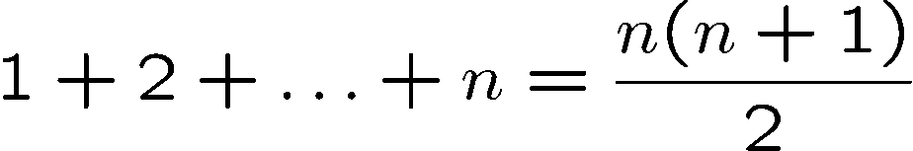
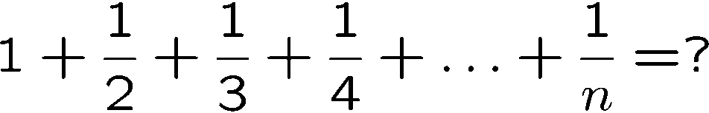
Sum of a Sequence
These equalities can be proven by induction (will learn later),
but how do we come up with the right hand side?

Slide 9
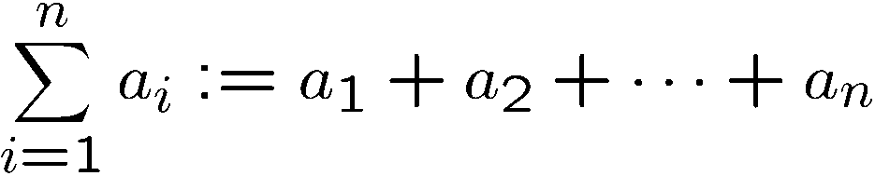
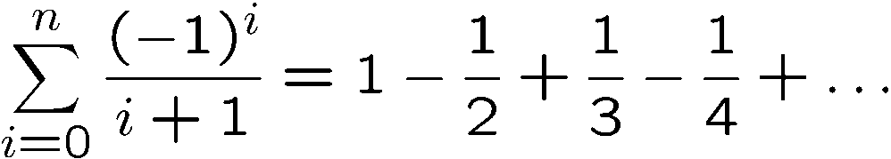
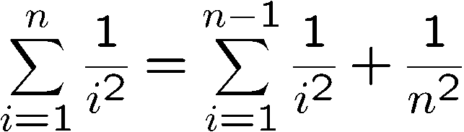
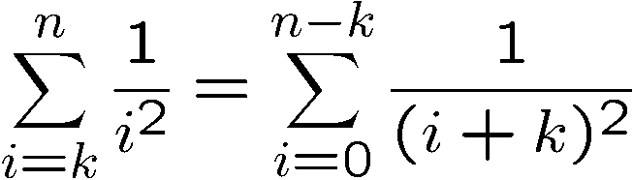
Summation
(adding or subtracting from a sequence)
(change of variable)

Slide 10
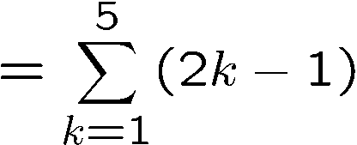
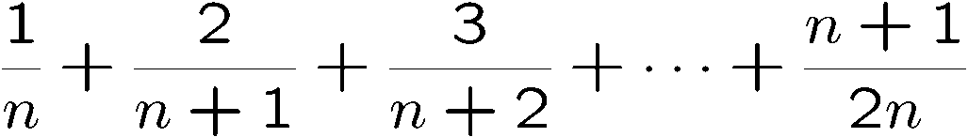
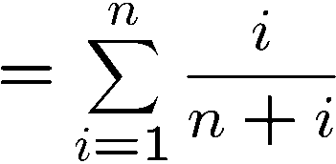
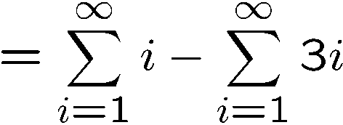
Summation
Write the sum using the summation notation.

Slide 11
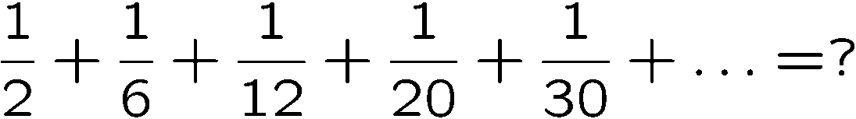

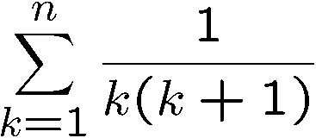
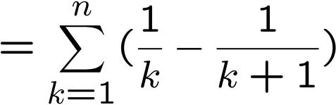
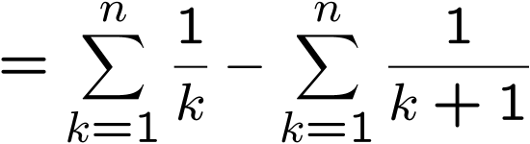
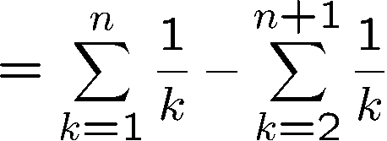
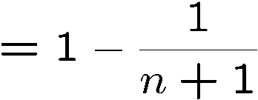
A Telescoping Sum
Step 1: Find the general pattern.
a_{i} = 1/i(i+1)
Step 2: Manipulate the sum.
(partial fraction)
(change of variable)

Slide 12
This Lecture
Representation of a sequence
Sum of a sequence
  Arithmetic sequence
  Geometric sequence
    Applications
  Harmonic sequence
  (Optional) The integral method
Product of a sequence
  Factorial

Slide 13
Sum for Children
89 + 102 + 115 + 128 + 141 +
154 + ··· +
193 + ··· +
232 + ··· +
323 + ··· +
414 + ··· + 453 + 466
Nine-year old Gauss saw
30 numbers, each 13 greater than the previous one.
1st + 30th = 89 + 466 = 555
2nd + 29th =
(1st+13) + (30th−13) = 555
3rd + 28th =
(2nd+13) + (29th−13) = 555
So the sum is equal to 15x555 = 8325.

Slide 14
Arithmetic Sequence
A number sequence is called an arithmetic sequence if a_{i+1} = a_{i}+d for all i.
e.g. 1,2,3,4,5,… 5,3,1,-1,-3,-5,-7,…
What is the formula for the n-th term?
a_{i+1} = a₁ + i·d
(can be proved by induction)
What is the formula for the sum S=1+2+3+4+5+…+n?
Write the sum S = 1 + 2 + 3 + … + (n-2) + (n-1) + n
Write the sum S = n + (n-1) + (n-2) + … + 3 + 2 + 1
Adding terms following the arrows, the sum of each pair is n+1.
We have n pairs, and therefore 2S = n(n+1), and thus S = n(n+1)/2.

Slide 15
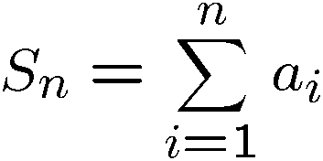

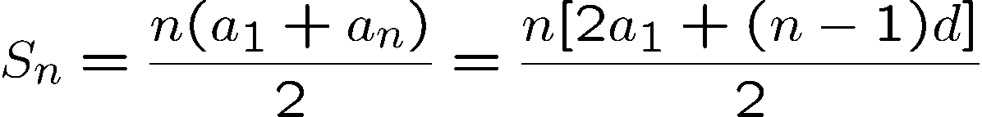
Arithmetic Sequence
A number sequence is called an arithmetic sequence if a_{i+1} = a_{i}+d for all i.
What is a simple expression of the sum?
Adding the equations together gives:
Rearranging and remembering that a_{n} = a₁ + (n − 1)d, we get:

Slide 16
This Lecture
Representation of a sequence
Sum of a sequence
  Arithmetic sequence
  Geometric sequence
    Applications
  Harmonic sequence
  (Optional) The integral method
Product of a sequence
  Factorial

Slide 17
Geometric Sequence
A number sequence is called a geometric sequence if a_{i+1} = r·a_{i} for all i.
e.g. 1, 2, 4, 8, 16,… 1/2, -1/6, 1/18, -1/54, 1/162, …
What is the formula for the n-th term?
a_{i+1} = r^{i}·a₁
(can be proved by induction)
What is the formula for the sum S=1+3+9+27+81+…+3^{n}?
Write the sum S = 1 + 3 + 9 + … + 3^{n-2} + 3^{n-1} + 3^{n}
Write the sum 3S = 3 + 9 + … + 3^{n-2} + 3^{n-1} + 3^{n} + 3^{n+1}
Subtracting the second equation by the first equation,
we have 2S = 3^{n+1} - 1, and thus S = (3^{n+1} – 1)/2.

Slide 18
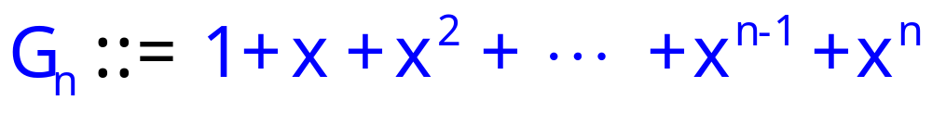
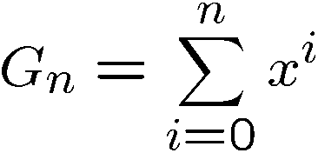
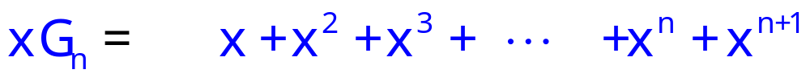
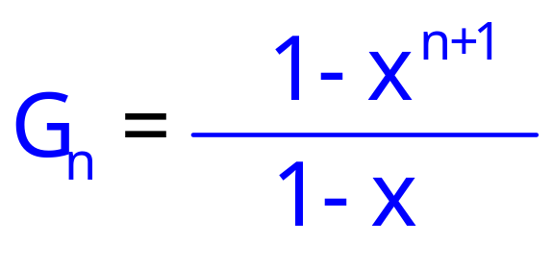
Geometric Series
What is a simple expression of G_{n}?
G_{n}−xG_{n}=
1
− x^{n+1}

Slide 19
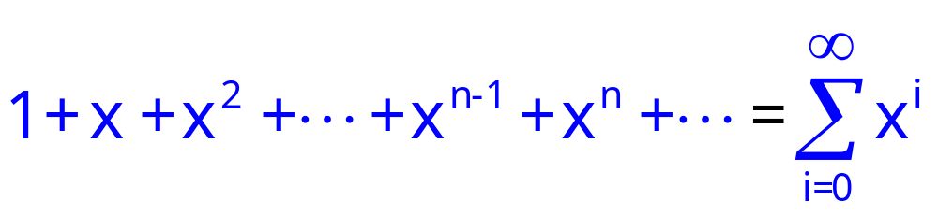
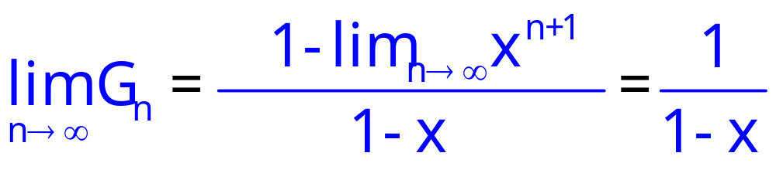
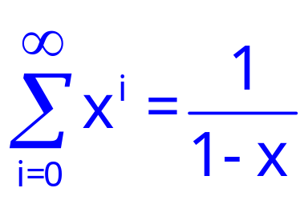
Infinite Geometric Series
Consider infinite sum (series)
for |x| < 1

Slide 20
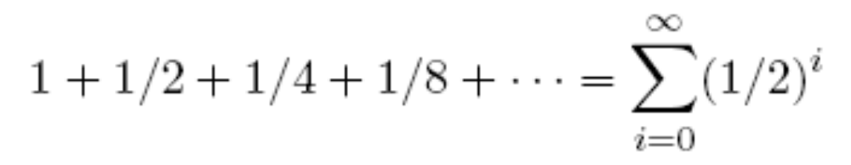

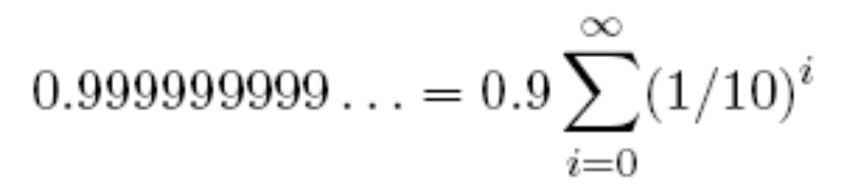


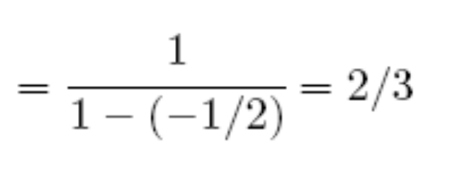
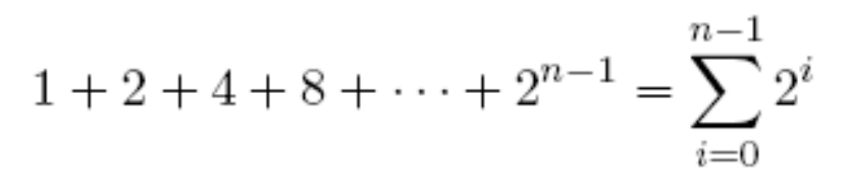
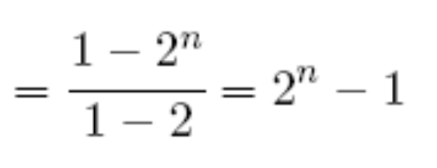
Some Examples

Slide 21
This Lecture
Representation of a sequence
Sum of a sequence
  Arithmetic sequence
  Geometric sequence
    Applications
  Harmonic sequence
  (Optional) The integral method
Product of a sequence
  Factorial

Slide 22
The Value of an Annuity
Would you prefer a million dollars today
or $50,000 a year for the rest of your life?
An annuity is a financial instrument that pays out
a fixed amount of money at the beginning of
every year for some specified number of years.
Examples: lottery payouts, student loans, home mortgages.
Is an annuity worthy?
In order to answer this question, we need to know
what a dollar paid out in the future is worth today.

Slide 23
The Future Value of Money
My bank will pay me 3% interest. define bankrate
b ::= 1.03
-- bank increases my $ by this factor in 1 year.
So if I have $X today,
One year later I will have $bX
Therefore, to have $1 after one year,
It is enough to have
b⋅X ≥ 1.
X ≥ $1/1.03 ≈ $0.9709

Slide 24
The Future Value of Money
$1 in 1 year is worth $0.9709 now.
$1/b last year is worth $1 today,
So $n paid in 2 years is worth
$n/b paid in 1 year, and is worth
$n/b² today.
$n paid k years from now
is only worth $n/b^{k} today

Slide 25
Annuities
$n paid k years from now
is only worth $n/b^{k} today
Someone pays you $100/year for 10 years.
Let r ::= 1/bankrate = 1/1.03
In terms of current value, this is worth:
100r + 100r² + 100r³ +  + 100r¹⁰
= 100r(1+ r +  + r⁹)
= 100r(1−r¹⁰)/(1−r) = $853.02

Slide 26
Annuities
I pay you $100/year for 10 years,
if you will pay me $853.02.
QUICKIE: If bankrates unexpectedly
increase in the next few years,
  You come out ahead
  The deal stays fair
  I come out ahead

Slide 27
Annuities
Would you prefer a million dollars today
or $50,000 a year for the rest of your life?
Let r = 1/bankrate
In terms of current value, this is worth:
50000 + 50000r + 50000r² + 
= 50000(1+ r +  )
= 50000/(1−r)
If bankrate = 3%, then the sum is $1716666
If bankrate = 8%, then the sum is $675000

Slide 28
Loan
Suppose you were about to enter college today and a college loan officer offered you the following deal:
$25,000 at the start of each year for four years to pay for your college tuition and an option of choosing one of the following repayment plans:
Plan A: Wait four years, then repay $20,000 at the
start of each year for the next ten years.
Plan B: Wait five years, then repay $30,000 at the
start of each year for the next five years.
Assume interest rate 7%
Let r = 1/1.07.

Slide 29
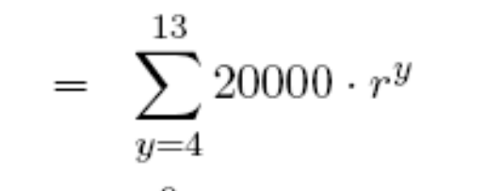

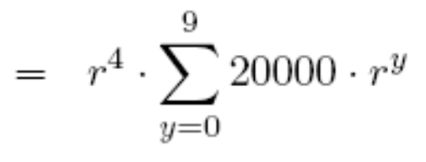

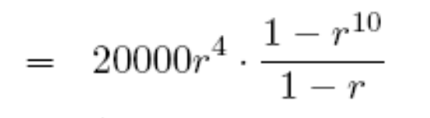

Plan A
Plan A: Wait four years, then repay $20,000 at the
start of each year for the next ten years.
Current value for plan A

Slide 30
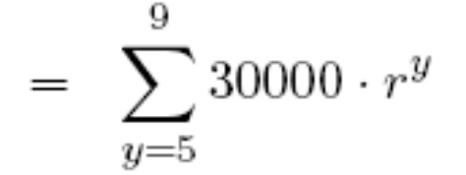
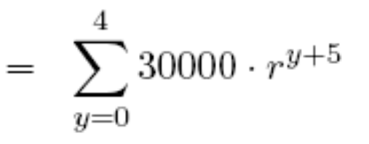
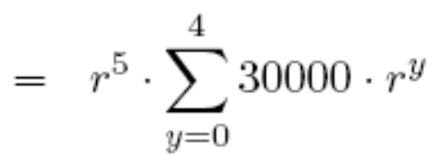
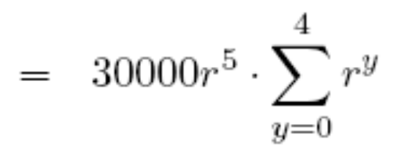
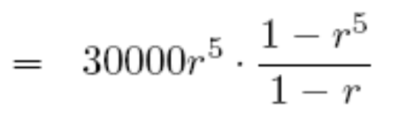

Plan B
Plan B: Wait five years, then repay $30,000 at the
start of each year for the next five years.
Current value for plan B

Slide 31
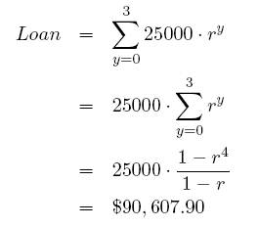
Profit
$25,000 at the start of each year for four years
to pay for your college tuition.
Loan office profit = $3233.

Slide 32
This Lecture
Representation of a sequence
Sum of a sequence
  Arithmetic sequence
  Geometric sequence
    Applications
  Harmonic sequence
  (Optional) The integral method
Product of a sequence
  Factorial

Slide 33
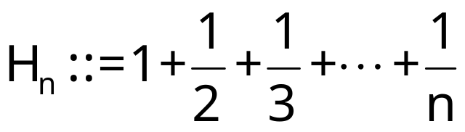

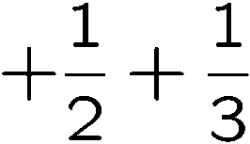
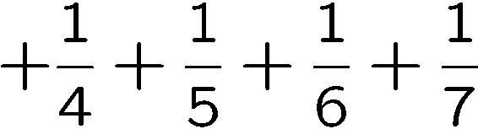
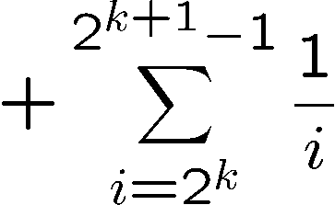
Harmonic Number
How large is
?
Finite or infinite?
1 number
2 numbers, each <= 1/2 and > 1/4
Row sum is <= 1 and >= 1/2
4 numbers, each <= 1/4 and > 1/8
Row sum is <= 1 and >= 1/2
…
2^{k} numbers, each <= 1/2^{k} and > 1/2^{k+1}
Row sum is <= 1 and >= 1/2
…
The sum of each row is <=1 and >= 1/2.

Slide 34

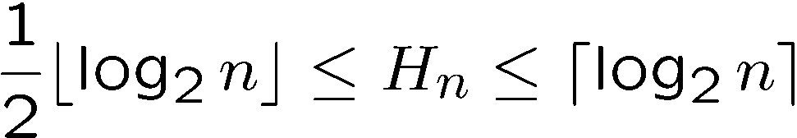
Harmonic Number
How large is
?
k rows have totally 2^{k}-1 numbers.
If n is between 2^{k}-1 and 2^{k+1}-1,
there are >= k rows and <= k+1 rows,
and so the sum is at least k/2
and is at most (k+1).
…
…
The sum of each row is <=1 and >= 1/2.

Slide 35
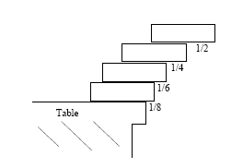
Overhang (Optional)
How far can you reach?
?
overhang
If we use n books,
the distance we can reach
is at least H_{n}/2, and
thus we can reach infinity!

Slide 36
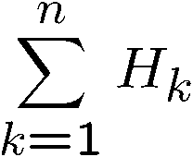
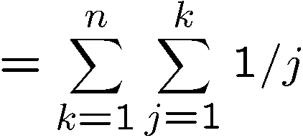

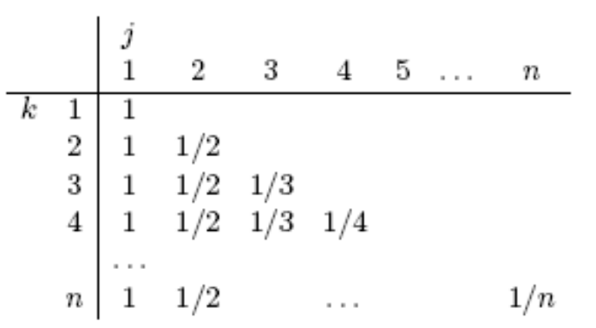
Double Summation (Optional)
What is ?
A useful trick to deal with double sum is to “switch” the order of the summation.
The sum we are computing is
the sum of the numbers
in this two dimensional table.
The summation above is summing each row and then add the row sums.

Slide 37
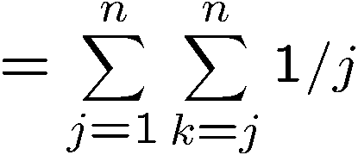
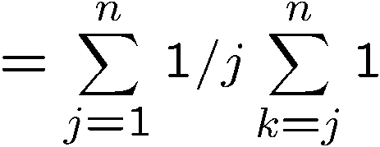





Double Summation (Optional)
Alternatively, we can sum the columns and add the column sums.
(after switching the inner term does not depend on k)

Slide 38
This Lecture
Representation of a sequence
Sum of a sequence
  Arithmetic sequence
  Geometric sequence
    Applications
  Harmonic sequence
  (Optional) The integral method
Product of a sequence
  Factorial

Slide 39
Harmonic Number
1
There is a general method to estimate
H_{n}. First, think of the sum as the
total area under the “bars”.
Instead of computing this area,
we can compute a “smooth” area
under the curve 1/(x+1), and the
“smooth” area can be computed
using integration techniques easily.
1
x+1
1
2
1
3
1
1
2
1
3
0 1 2 3 4 5 6 7 8

Slide 40




Integral Method (Optional)
The area under the curve 1/(x+1)
<=
The area under the bars
Similarly we can obtain a lower bound for H_{n} using the integration method.
The area under the curve 1/x
>=
The area under the bars

Slide 41





More Integral Method (Optional)
What is a simple closed form expressions of ?
Idea: use integral method.
So we guess that
Make a hypothesis

Slide 42





Sum of Squares (Optional)
Make a hypothesis
Plug in a few value of n to determine a,b,c,d.
Solve this linear equations gives a=1/3, b=1/2, c=1/6, d=0.
Go back and check (by induction) if

Slide 43
This Lecture
Representation of a sequence
Sum of a sequence
  Arithmetic sequence
  Geometric sequence
    Applications
  Harmonic sequence
  (Optional) A general method
Product of a sequence
  Factorial

Slide 44






Product

Slide 45







Factorial
Factorial defines a product:
How to estimate n!?
Too rough…
Still very rough, but at least show that it is much larger than C^{n} for any constant C.

Slide 46

Factorial
Factorial defines a product:
How to estimate n!?
Turn product into a sum taking logs:
ln(n!) = ln(1·2·3 ··· (n – 1)·n)
= ln 1 + ln 2 + ··· + ln(n – 1) + ln(n)

Slide 47


Integral Method (Optional)
ln n
ln (x)
ln (x+1)
ln 5
ln 4
ln 3
ln
n-1
ln n
ln 5
ln 2
ln 4
…
ln 3
ln 2
1
2
3
4
5
n–2
n–1
n
exponentiating:
Stirling’s formula:

Slide 48
Quick Summary
You should understand the basics of number sequences,
and understand and apply the sum of arithmetic and geometric
sequences. Harmonic sequence is useful in analysis of algorithms.
In general you should be comfortable dealing with new sequences.
The methods using differentiation and integration are optional,
but they are the key to compute formulas for number sequences.
The Stirling’s formula is very useful in probability, but we won’t
use it much in this course.

